Slide 1
Fundamentals of EMC
Dipole Antenna Basics
John McCloskey
NASA/GSFC Chief EMC Engineer
Code 565
Building 29, room 104
301-286-5498
John.C.McCloskey@nasa.gov

Slide 2
Topics
Intentional and Unintentional Antennas
Transmission Line Model Review
From Transmission Lines to Dipoles
Elemental Dipoles
Linear Dipole

Slide 3
Intentional Radiators, a.k.a. Antennas
An antenna is a transducer between conducted and radiated energy
An antenna is made by establishing an RF potential between two conductors
Capacitance between the two conductors provides current path
I_{T}
I_{R}
+
H
+
V_{T}
V_{R}
-
-
E

Slide 4
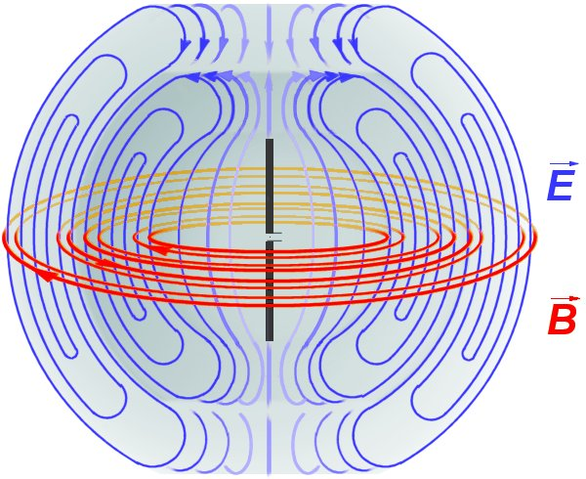
Transmitting Antennas
When an antenna radiates, it means that it is transmitting power
Transmitted power P_{t} is related to the square of the rms current through the radiation resistance R_{r} of the antenna:
E
I_{rms}
Poynting Vector
H
Direction of propagation
Power density in W/m²
(V/m x A/m)

Slide 5
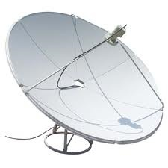
Receiving Antennas
Receiving antenna converts incident electric field into received voltage
  Conversion factor between power density (W/m²) into received power (W) is called Effective Aperture (m²)
  Conversion factor between E-field (V/m) into V is called Effective Height (m)
    Inverse is called Antenna Factor (1/m)
Receiver front end
Input power density, P_{D} (W/m²)
x effective aperture, A_{e} (m²)
  = Gλ²/(4π)
  = Gc²/(4πf²)
= output power, P (W)
Input electric field, E (V/m)
P_{D}= E²/120π
x effective height, h_{e} (m)
  = V/E
output RF potential (V)
P = V²/R
R = 50 Ω typical
  Antenna Factor (AF)
= E/V = 1/h_{e}

Slide 6
Unintentional Radiators, a.k.a. Antennas
If any part of your equipment radiates or is susceptible to radio frequency (RF) energy, you have created an antenna whether or not you call it one
Recall: An antenna is made by establishing an RF potential between two conductors
These can be any two conductors, e.g.:
  Cable and chassis
  Cable and ground plane (structure)
  PC board trace and chassis
  Poorly bonded connector and chassis (seams on chassis)
  Etc.
RADIATED EMISSIONS
I_{cm}
I_{cm}
I_{cm}

Slide 7
Transmission Line Model (Lossy)
I
V_{S}
I
R
L
V(z)
V(z + Δz)
I(z)
I(z + Δz)
R = series resistance per unit length (Ω/m)
L = series inductance per unit length (H/m)
G = shunt conductance per unit length (Ω⁻¹/m)
C = shunt capacitance per unit length (F/m)
G
C

Slide 8
Transmission Line Model (Lossless)
I
V_{S}
I
V(z)
L
V(z + Δz)
I(z)
I(z + Δz)
L = series inductance per unit length (H/m)
C = shunt capacitance per unit length (F/m)
C

Slide 9
From Transmission Lines to Dipoles
(PRETEND THIS IS AN ANIMATION)
V_{S}

Slide 10
From Transmission Lines to Dipoles (cont.)
L
I
R_{r} =
Radiation
Resistance
V_{S}
V_{S}
I
C

Slide 11
From Transmission Lines to Dipoles (cont.)
When reactive impedance elements cancel:
  Dipole impedance is completely real (radiation resistance)
  Dipole is an efficient radiator
L
When:
R_{r} =
Radiation
Resistance
V_{S}
i.e.:
C

Slide 12
From Transmission Lines to Dipoles (cont.)
Significance of radiation resistance (R_{r})
  NOT a physical resistor
  Relates current on dipole to transmitted power (P α I²)
L
I
Poynting Vector
H
H
V_{S}
R_{r}
I
E
E
C

Slide 13
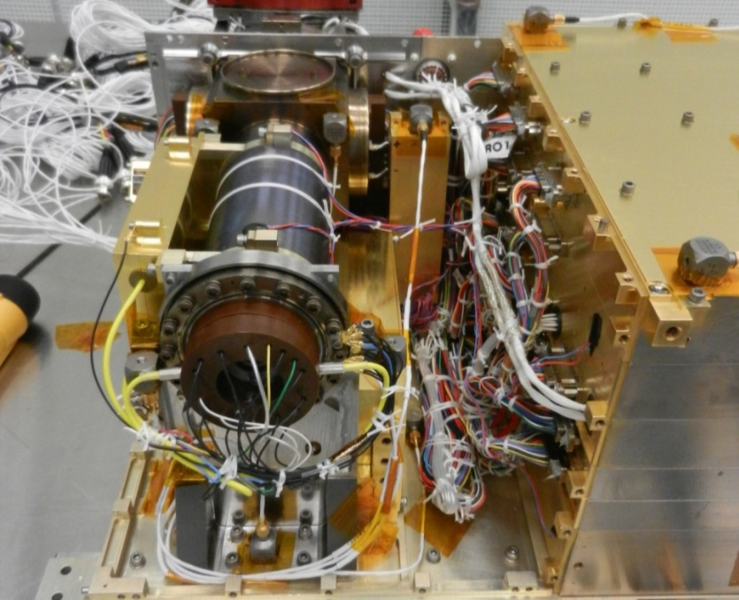
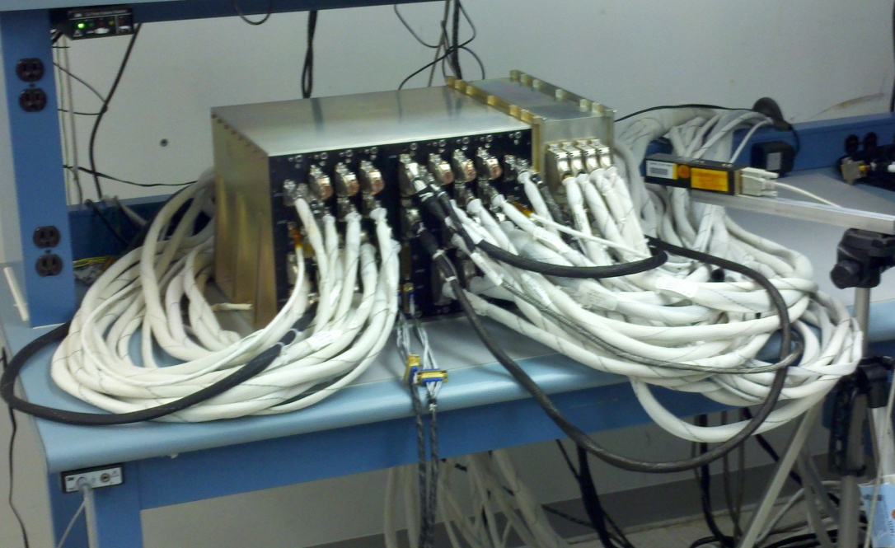
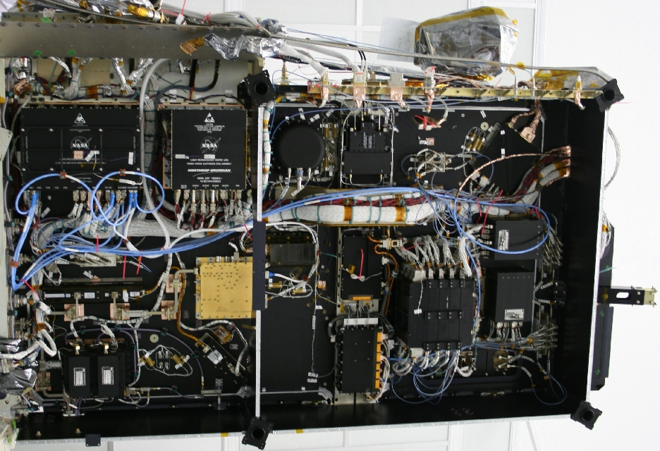
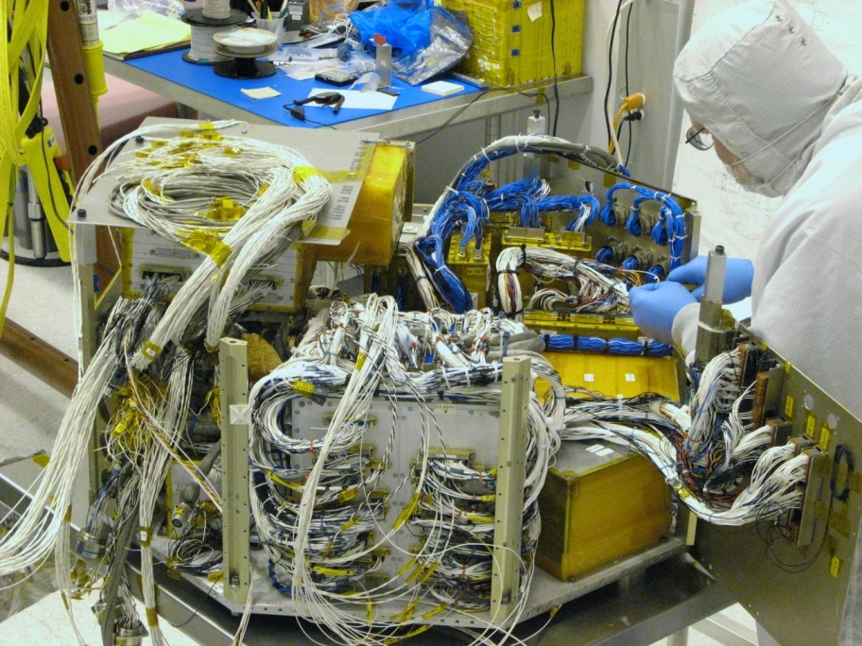
Can You Find the Dipoles in These Pictures?

Slide 14
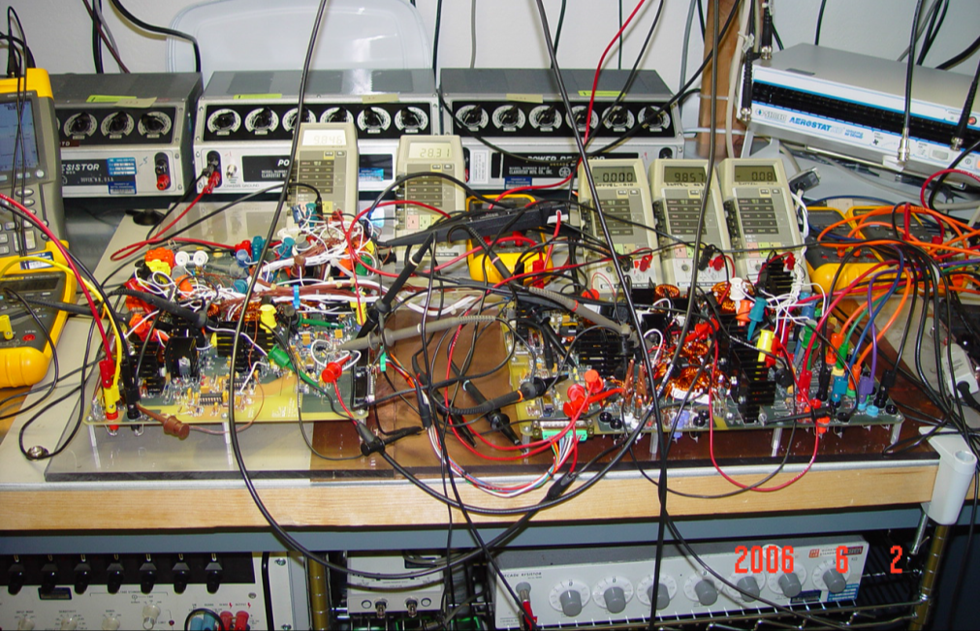
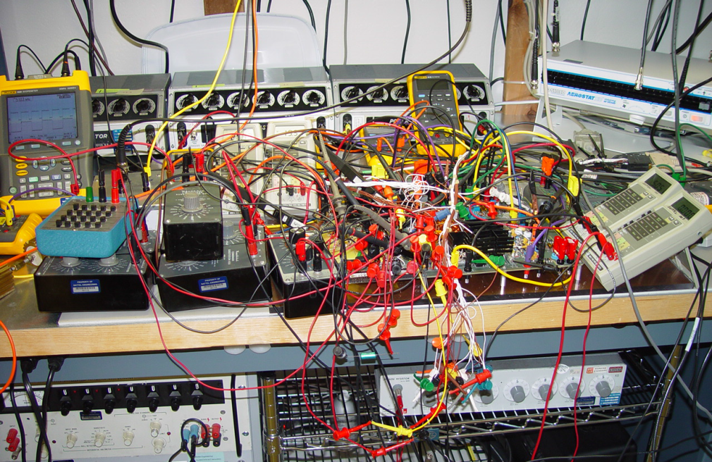
Can You Find the Dipoles in These Pictures (cont.)?

Slide 15
Near and Far Fields of Elemental Dipoles
Electric (Hertzian) Dipole
z
θ
r
Complex dependence on 1/r and 1/r² in near field
Complex dependence on 1/r, 1/r², & 1/r³ in near field
dl
y
x
Wavenumber:
Only 1/r dependence remains in far field
Only 1/r dependence remains in far field
z
Magnetic (Loop) Dipole
θ
r
Complex dependence on 1/r, 1/r², & 1/r³ in near field
I
Complex dependence on 1/r and 1/r² in near field
b
y
x
Only 1/r dependence remains in far field
Only 1/r dependence remains in far field
Magnetic dipole moment:

Slide 16
Wave Impedances of Elemental Dipoles
Electric (Hertzian) Dipole
z
θ
r
dl
y
x
z
Magnetic (Loop) Dipole
θ
r
I
y
b
x
Magnetic dipole moment:

Slide 17
Wave Impedances of Elemental Dipoles (cont.)
(CROSSTALK)
(RADIATED EMISSIONS)

Slide 18
Linear Dipole
z
R’
θ
h
R
dz
I_{m}
h
= 0 with symmetrical integration limits
But:
CONTINUED…

Slide 19
Linear Dipole (cont.)
Pattern Function:

Slide 20
F(θ), 2h = 0.1λ – 0.5λ

Slide 21
Linear Dipole (cont.)
Evaluated numerically
For half-wave dipole, 2h = λ/2, β₀h = π/2:

Slide 22
Half-Wave Dipole
MAXIMUM POWER TRANSMITTED WHEN 2h = λ/2
h = λ/4
L
R_{r} =
Radiation
Resistance
H
V_{S}
E
h = λ/4
C

Slide 23
Quarter-Wave Monopole
MAXIMUM POWER TRANSMITTED WHEN 2h = λ/4
L
R_{r} =
Radiation
Resistance
H
h = λ/4
E
C
V_{S}

Slide 24
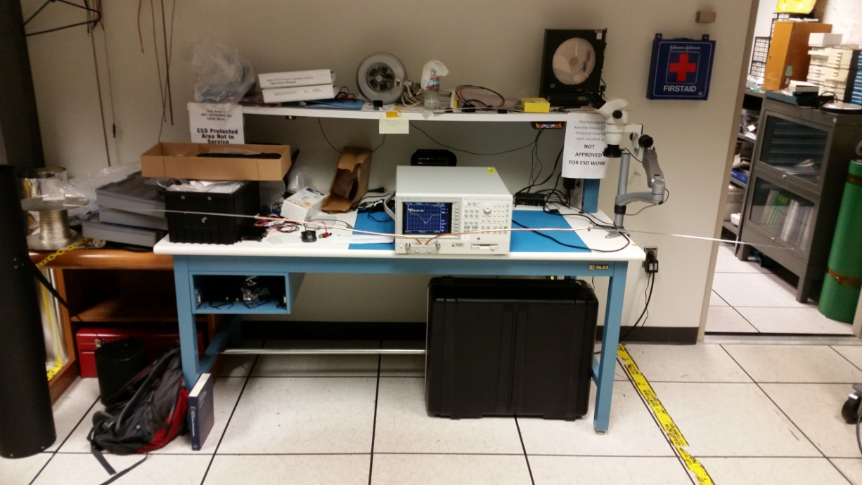
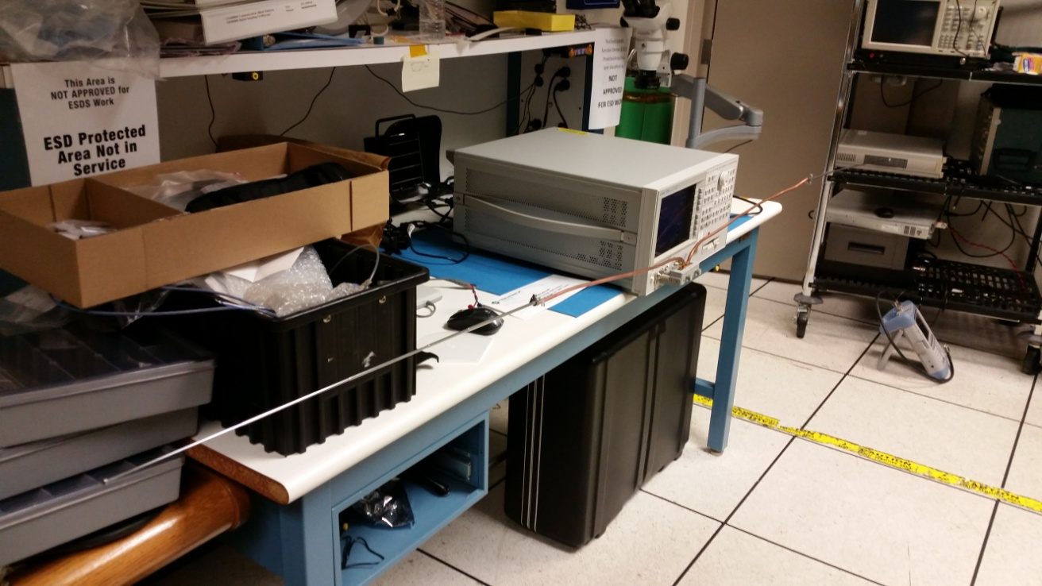
Demonstration: Dipole Impedance
Dipole length
2h = 2.6 m
= λ/2 @ 58 MHz

Slide 25
Demonstration: Dipole Impedance (cont.)

Slide 26

Why Do We Care About Dipole Impedance?
MINIMUM IMPEDANCE
MAXIMUM CURRENT FOR GIVEN DRIVE POTENTIAL
MAXIMUM TRANSMITTED POWER
HIGHER RADIATED EMISSIONS

Slide 27
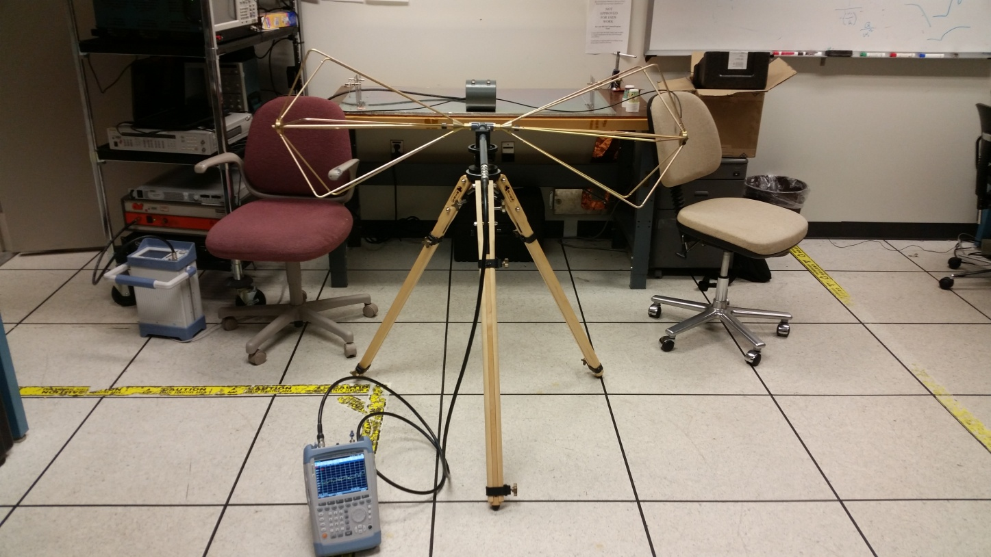
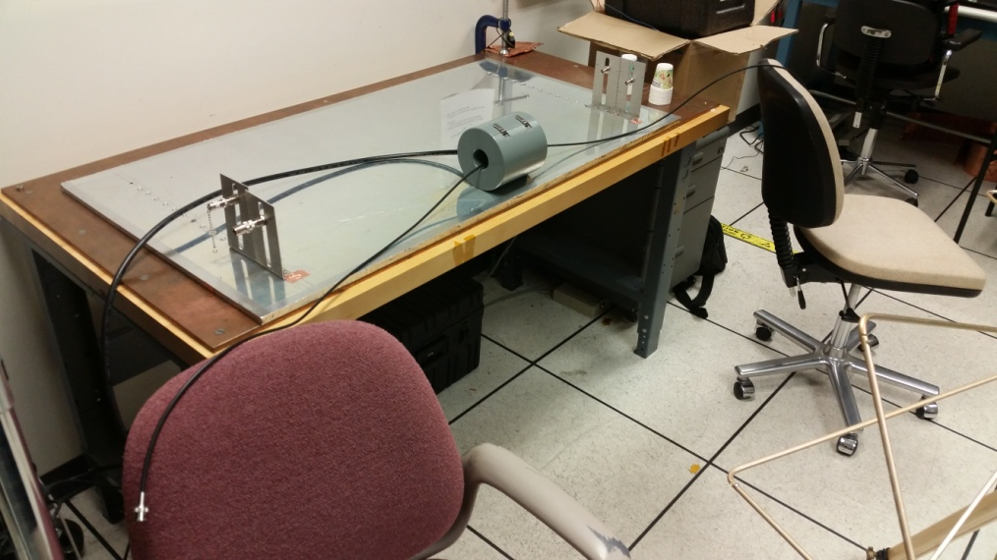
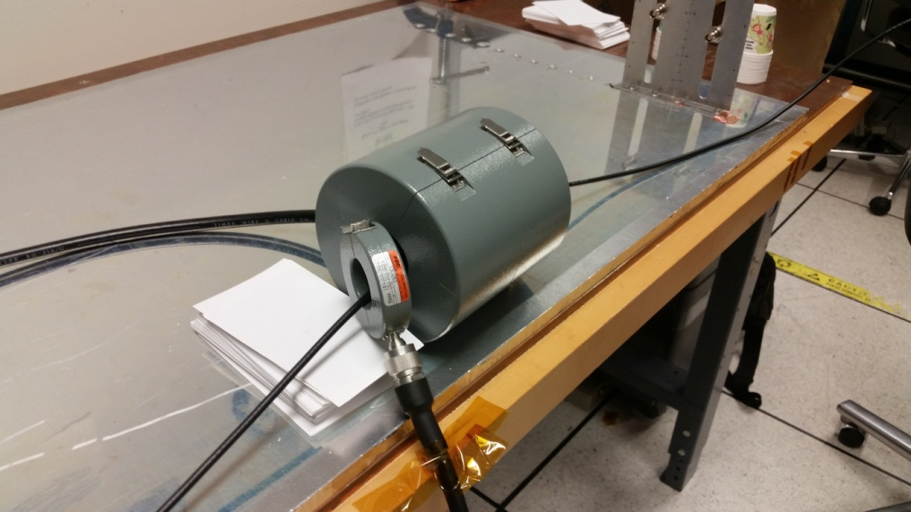
Conducted Emissions (CE) vs. Radiated Emissions (RE)
RE measured with biconical antenna
CE measured with current probe
2 m dipole

Slide 28
CE vs. RE for 2 m Dipole (0 dBm applied signal)

Slide 29
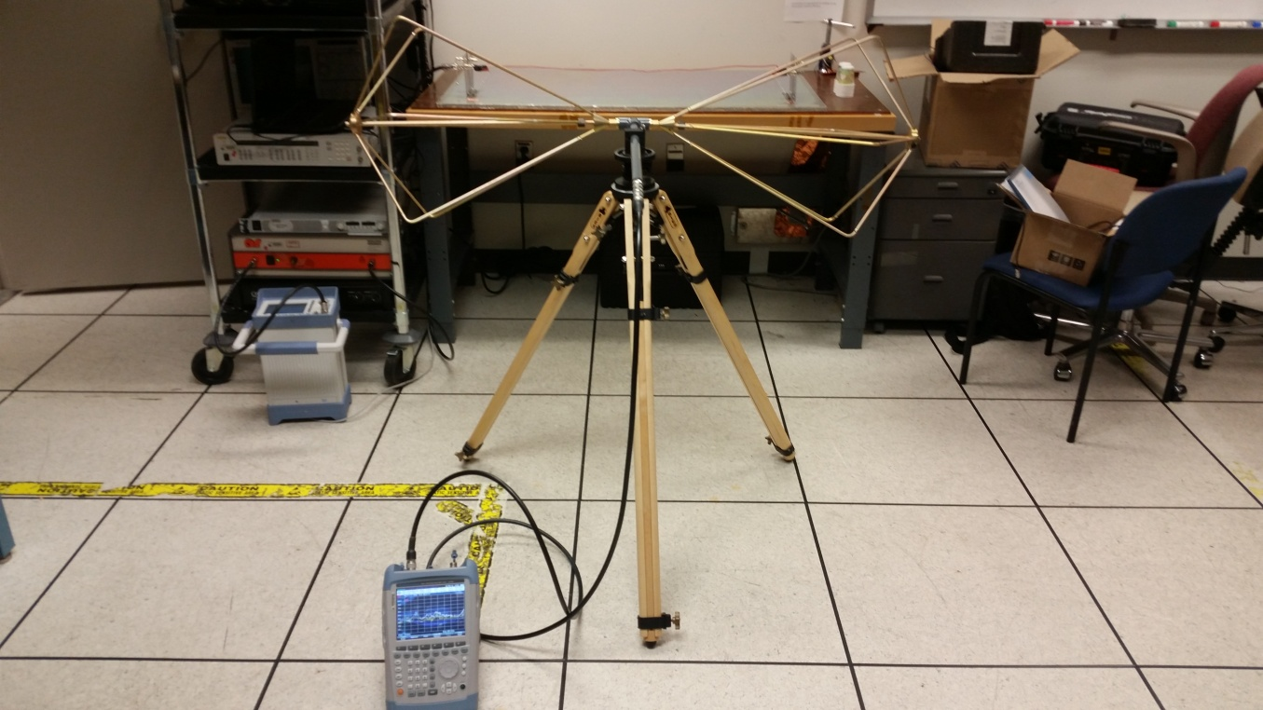
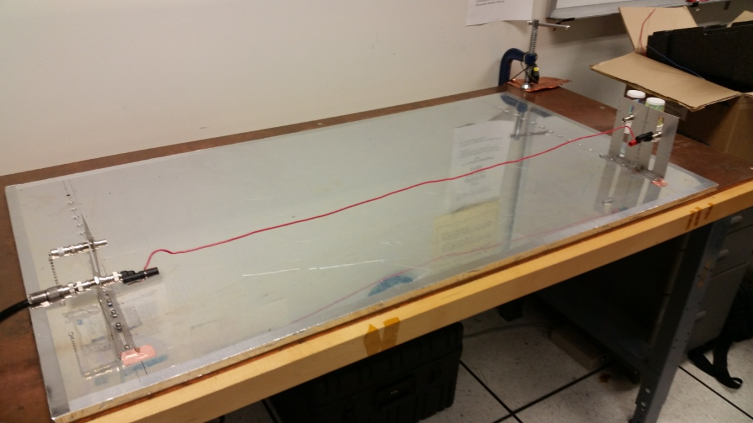
CE vs. RE (cont.)
RADIATED EMISSIONS FROM
UNSHIELDED WIRE 10 cm ABOVE GROUND PLANE

Slide 30
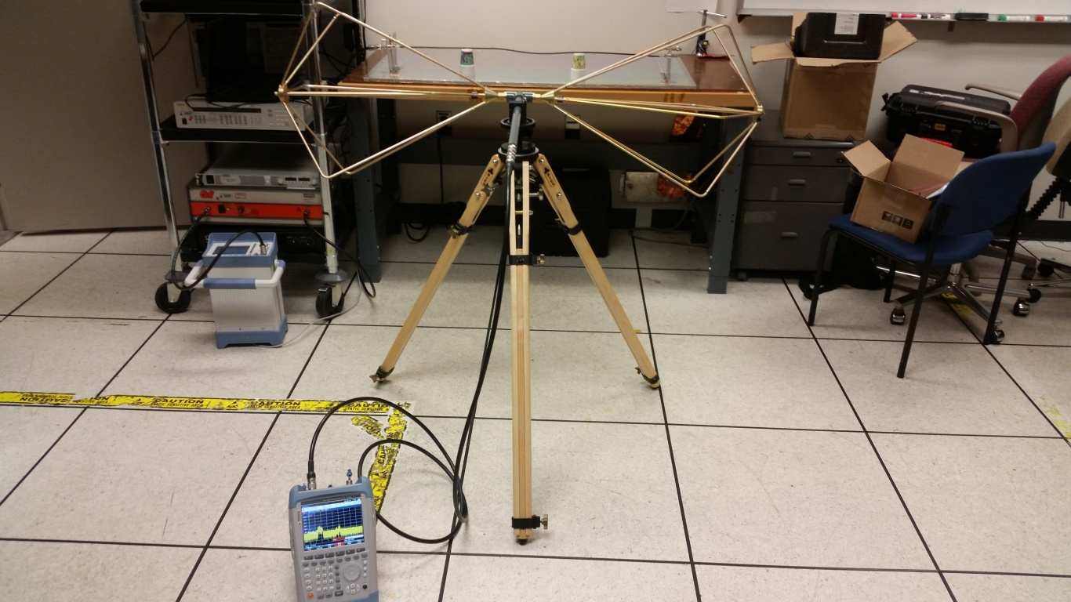
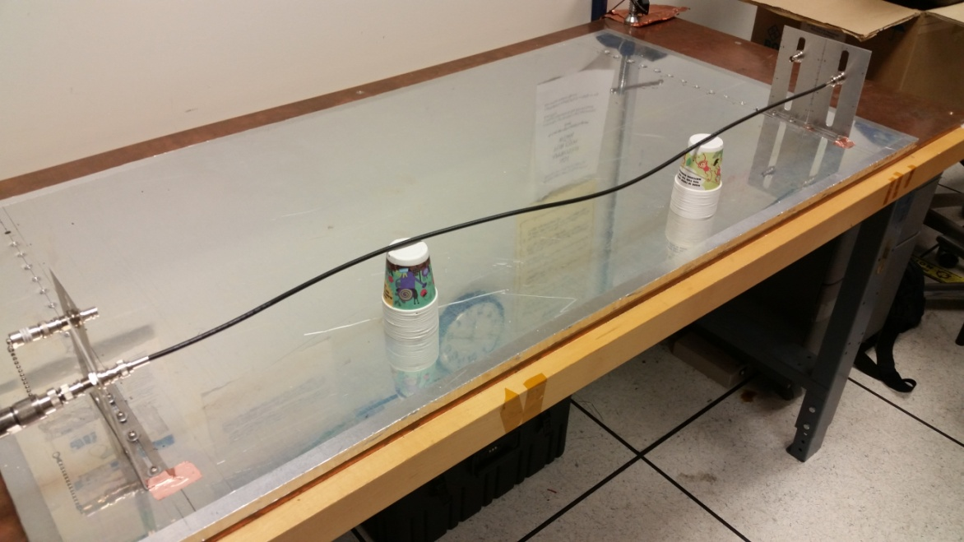
CE vs. RE (cont.)
RADIATED EMISSIONS FROM COAXIAL CABLE 10 cm ABOVE GROUND PLANE

Slide 31
CE vs. RE of Wire vs. Coax

Slide 32
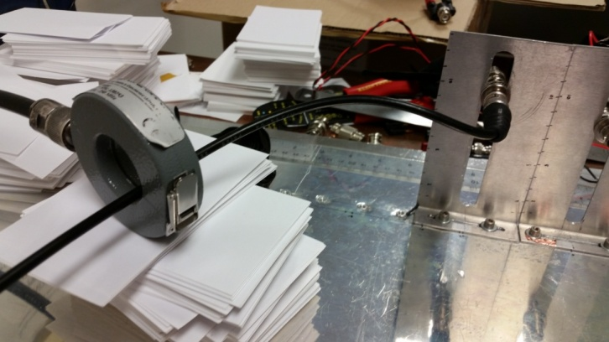
Remember This?
Coax reduces CM current as well as radiated emissions

Slide 33

Key Points
Radiated emissions scale with common mode current
Shielded cables (particularly coax) significantly reduce common mode currents
Shielded cables (particularly coax) significantly reduce radiated emissions
Control common mode current → control radiated emissions
COINCIDENCE?
I THINK NOT!!!!

Slide 34
If You Remember Nothing Else From Today…
DO YOU KNOW WHERE YOUR CURRENTS ARE FLOWING?

